Slide 1
About Me
Ritesh Singh
Sun Certified java Professional
Oracle Certified Database Administrator
Certified Ethical Hacker
Certified EC-Council Instructor (CEI)

Slide 2
Course Overview
SQL Comparison Operators

Slide 3
SQL Comparison Operators
The SQL comparison operators allow you to test if two expressions are the same. The following table illustrates the comparison operators in SQL:
The result of a comparison operator has one of three value true, false, and unknown.
Operator | Meaning
= | Equal
<> | Not equal to
> | Greater than
>= | Greater than or equal to
< | Less than
<= | Less than or equal to

Slide 4
Equal to operator(=)
The equal to operator compares the equality of two expressions:
expression1 = expression2
It returns true if the value of the left expression is equal to the value of the right expression; otherwise, it returns false.

Slide 5

For example, the following statement finds the employee whose last name is Himuro:
SELECT employee_id, first_name, last_name FROM employees WHERE last_name = 'Himuro';
In this example, the query searches for the string Himuro in the last_name column of the employees table.
Note that the equal operator cannot be used to compare null values.

Slide 6
For example, the intention of the following query is to find all employees who do not have phone numbers:
SELECT
employee_id, first_name, last_name, phone_number
FROM
employees
WHERE
phone_number = NULL;
However, it returns an empty result set because the following expression always returns false.
phone_number = NULL

Slide 7
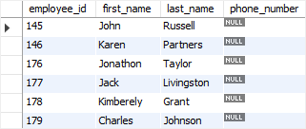
To compare null values, you use the IS NULL operator instead:
SELECT
employee_id, first_name, last_name, phone_number
FROM
employees
WHERE
phone_number IS NULL;

Slide 8
Not equal to operator (<>)
The not equal to (<>) operator compares two non-null expressions and returns true if the value of the left expression is not equal to the right one; otherwise, it returns false.
expression1 <> expression2
For example, the following statement returns all employees whose department id is not 8.

Slide 9
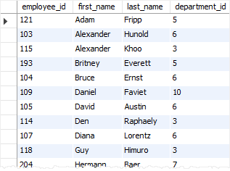
SELECT employee_id, first_name, last_name, department_id FROM employees WHERE department_id <> 8 ORDER BY first_name , last_name;

Slide 10
You can use the AND operator to combine multiple expressions that use the not equal to (<>) operator. For example, the following statement finds all employees whose department id is not eight and ten.
SELECT employee_id, first_name, last_name, department_id FROM employees WHERE department_id <> 8 AND department_id <> 10 ORDER BY first_name , last_name;

Slide 11
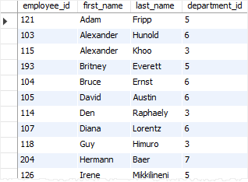

Slide 12
Greater than operator (>)
The greater than operator (>) compares two non-null expressions and returns true if the left operand is greater than the right operand; otherwise, the result is false.
expression1 > expression2

Slide 13
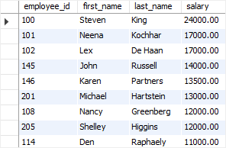
For example, to find the employees whose salary is greater than 10,000, you use the greater than operator in the WHERE clause as follows:
SELECT employee_id, first_name, last_name, salary FROM employees WHERE salary > 10000 ORDER BY salary DESC;

Slide 14

You can combine expressions that use various comparison operators using the AND or OR operator. For example, the following statement finds employees in department 8 and have the salary greater than 10,000:
SELECT employee_id, first_name, last_name, salary FROM employees WHERE salary > 10000 AND department_id = 8 ORDER BY salary DESC;

Slide 15
Less than operator (<)
The less than operator compares two non-null expressions. The result is true if the left operand evaluates to a value that is lower than the value of the right operand; otherwise, the result is false.
The following shows the syntax of the less than operator:

Slide 16
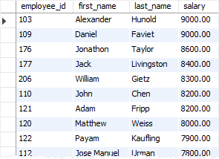
expression1 < expression2
For example, the statement below returns all employees whose salaries are less than 10,000:
SELECT
employee_id, first_name, last_name, salary
FROM
employees
WHERE
salary < 10000
ORDER BY salary DESC;

Slide 17
Greater than or equal operator (>=)
The greater than or equal operator (>=) compares two non-null expressions. The result is true if the left expression evaluates to a value that is greater than the value of the right expression.
The following illustrates the syntax of the greater than or equal operator:

Slide 18
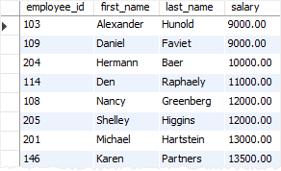
expression1 >= expression2
For example, the following statement finds employees whose salaries are greater than or equal 9,000:
SELECT
employee_id, first_name, last_name, salary
FROM
employees
WHERE
salary >= 9000
ORDER BY salary;

Slide 19
Less than or equal to operator(<=)
The less than or equal to operator compares two non-null expressions and returns true if the left expression has a value less than or equal the value of the right expression; otherwise, it returns true.
The following shows the syntax of the less than or equal to operator:
expression1 <= expression2

Slide 20
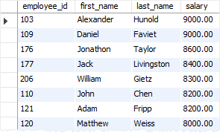
For example, the following statement finds employees whose salaries are less than or equal to 9,000:

Slide 21
Thank You
Please Subscribe My Channel
https://www.youtube.com/channel/UCYW3PWPOPn3qgxxjhUbXXXg?view_as=subscriber

